Slide 1
Object oriented programming
As explained by two amateurs

Slide 2


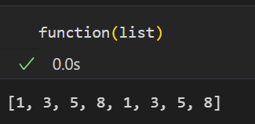
Functional programming
Input
Functions
Output

Slide 3
Object oriented programming
Input
(attributes)
Object
Class
Functions
(methods)
Output

Slide 4
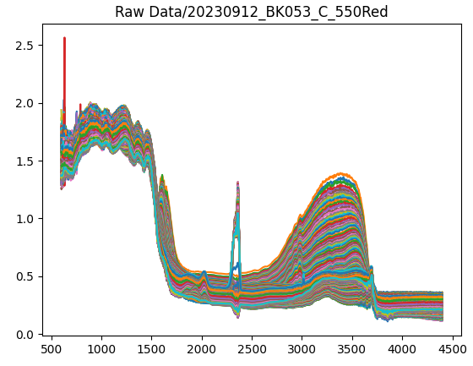
Example: 4 levels of coding
4 datasets of IR data
Goal: integrate the CO₂ signal and compare for all

Slide 5

4 levels?
Just write all your code under each other
Using functions
Using classes which use functions
Using dictionaries which use classes which use functions

Slide 6
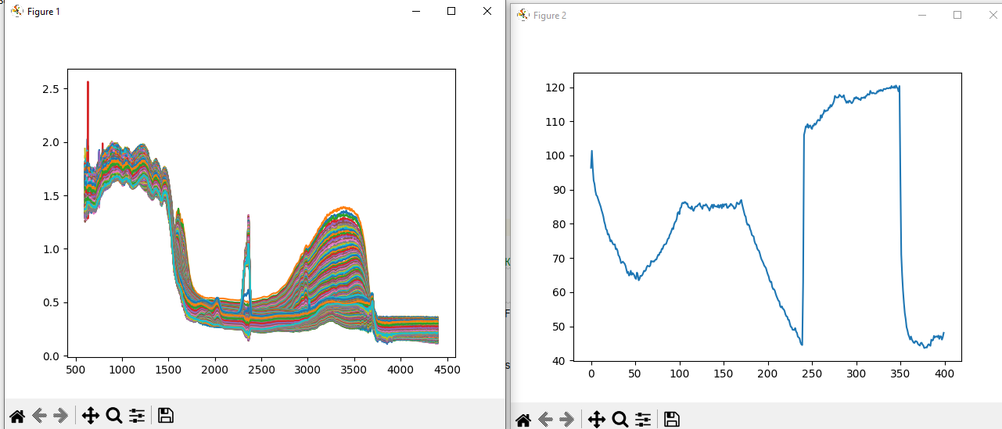
Level 1 to 3 - output

Slide 7
Level 1 – no functions
(import some packages)
FolderName = 'Raw Data/20230912_BK053_C_550Red' filelist = [] #Find all .dx files in the folder specified and add them to the list of files for root, dirs, files in os.walk(FolderName, topdown=True): for name in files: if '.dx' in name: filelist.append(os.path.join(root, name))
Find data
for files in filelist: #reading .dx file try: CurrentSpectrum = j.jcamp_readfile(files) except: print(str(CurrentNumber) + ' failed!!') # adding Y values of spectrum to DF DF = pd.concat([DF, pd.Series(CurrentSpectrum['y'])], axis=1)
Load data into dataframe
DF = DF.set_index(('Wavenumber')) DF = DF.transpose() DF.columns = DF.columns.map(to_float) DF = DF.reset_index(drop=True)
Rotate dataframe and fix wavenumbers

Slide 8
Level 1 – no functions
#Plotting all spectra AllSpectraFig = plt.figure() AllSpectraFigAx = AllSpectraFig.add_subplot() for i in DF.index: AllSpectraFigAx.plot(DF.columns,DF.iloc[i,:])v
Plot all spectra
(…) #then iterating over all spectra and integrating them for i in DF.index: #cut data to relevant area SpectrumToIntegrate = DF.iloc[i,HighWaveNumberIndex:LowWaveNumberIndex] CO2_area = scp.integrate.trapezoid(y=SpectrumToIntegrate, x=SpectrumToIntegrate.index) #saving negative since the data is saved from high to low wavenumbers which makes the integration negative. integrated_list.append(-CO2_area)
Integrate CO2 peak
CO2Fig = plt.figure() CO2FigAx = CO2Fig.add_subplot() CO2FigAx.plot(integrated_list) plt.show()
Plot CO2 peak and show plots

Slide 9
Level 2 - functions
def load_data(FolderName): filelist = [] #Find all .dx files in the folder specified and add them to the list of files for root, dirs, files in os.walk(FolderName, topdown=True): for name in files: if '.dx' in name: filelist.append(os.path.join(root, name)) #Load .dx files into dataframe firsttime = True for files in filelist: if firsttime: (…) #reading .dx file try: CurrentSpectrum = j.jcamp_readfile(files) except: print(str(CurrentNumber) + ' failed!!') # adding Y values of spectrum to DF DF = pd.concat([DF, pd.Series(CurrentSpectrum['y'])], axis=1) (…) #making the DF the way I want it- with the wavenumbers as columns and the spectra being the rows. DF = DF.set_index(('Wavenumber')) DF = DF.transpose() DF.columns = DF.columns.map(to_float) DF = DF.reset_index(drop=True) return DF
Function which takes the folder name
And returns dataframe

Slide 10
Level 2 - functions
def plot_allspectra(DF): # Plotting all spectra AllSpectraFig = plt.figure() AllSpectraFigAx = AllSpectraFig.add_subplot() for i in DF.index: AllSpectraFigAx.plot(DF.columns, DF.iloc[i, :]) def integrate_and_plot_CO2(DF): # Integrating CO2 peak # First finding some parameters for cutting the range Wavenumbers = DF.columns LowWaveNumberIndex = min(range(len(Wavenumbers)), key=lambda i: abs(Wavenumbers[i] - 2200)) HighWaveNumberIndex = min(range(len(Wavenumbers)), key=lambda i: abs(Wavenumbers[i] - 2400)) integrated_list = [] # then iterating over all spectra and integrating them for i in DF.index: # cut data to relevant area SpectrumToIntegrate = DF.iloc[i, HighWaveNumberIndex:LowWaveNumberIndex] CO2_area = scp.integrate.trapezoid(y=SpectrumToIntegrate, x=SpectrumToIntegrate.index) # saving negative since the data is saved from high to low wavenumbers which makes the integration negative. integrated_list.append(-CO2_area) # Plot CO2 band over time CO2Fig = plt.figure() CO2FigAx = CO2Fig.add_subplot() CO2FigAx.plot(integrated_list)v
More functions –
to plot all spectra (DF)
And integrate and plot CO2 (DF)

Slide 11
Level 2 - Functions
Structure:
Function load_data
Function plot_allspectra
Function integrate_and_plot_CO2
Code to run:
FolderName = 'Raw Data/20230913_BK053_A_RERUN_correctmethod'
DF_A = load_data(FolderName)
plot_allspectra(DF_A)
integrate_and_plot_CO2(DF_A)
plt.show()

Slide 12
Level 3: using a class
You can create a class and assign it variables and functions
When you create an object of that class type, this object will have these functions variables.
You can use the __init__ function which is called when the object is created
You can assign variables using self.variable
Variables are attributes
Functions are methods

Slide 13
Level 3: using a class
We now will introduce a class called IR_dataset
class IR_dataset: def __init__(self,FolderName): self.filelist = [] # Find all .dx files in the folder specified and add them to the list of files for root, dirs, files in os.walk(FolderName, topdown=True): for name in files: if '.dx' in name: self.filelist.append(os.path.join(root, name))
This class has it’s own function __init__ which is called when we create an object of this class.
Dataset_A = IR_dataset(‘Folder A’)
Object Class Foldername

Slide 14
Level 3: using a class
Structure:
Class IR_dataset
def __init__(self, foldername)
Load data, make dataframe
….
self.DF
def plot_allspectra(self)
….
def integrate_and_plot_CO2(self)
….
FolderName = 'Raw Data/20230913_BK053_A_RERUN_correctmethod' A = IR_dataset(FolderName) A.plot_allspectra() A.integrate_and_plot_CO2() plt.show()

Slide 15
Level 4: using dictionaries for multiple datasets
Dictionaries are used to store objects/variables
You can define a dictionary:
Dictionary = {}
Dictionaries use key value pairs
Key = name of stored object (string)
Value = stored object
To add to dictionary:
Dictionary[Key] = Value
We can also add objects of our own class!

Slide 16
Level 4: using dictionaries for multiple datasets
Class IR_dataset
def __init__(self, FolderName)
def plot_allspectra(self)
def integrate_and_plot_CO2(self, plotCO2 = false)
…
self.integratedlist
Data_Dictionary = {}
RawDataFolders = (find folders with data)
For folder in RawDataFolders:
Data_Dictionary[folder] = IR_dataset(folder)
(Make fig)
For key, value in Data_Dictionary.items()
value.plot_allspectra()
value.integrate_and_plot_CO2
ax.plot(value.integratedlist, label=key)
Load data, make dataframe
Plot spectra in dataframe
Integrate CO2
Define dictionary
For every dataset we have,
Create an object of our class and place it in the dictionary
For every object in our dictionary
Plot all spectra
Integrate CO2
And add the CO2 list to our plot

Slide 17
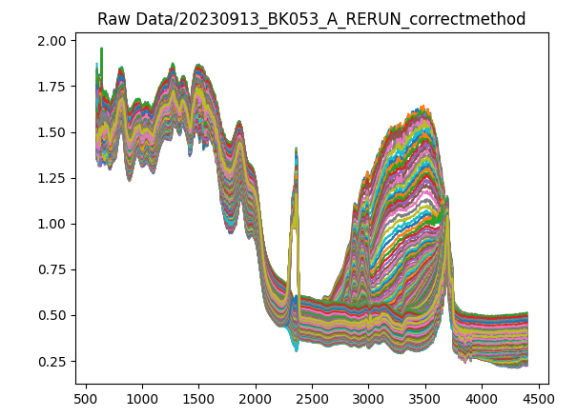
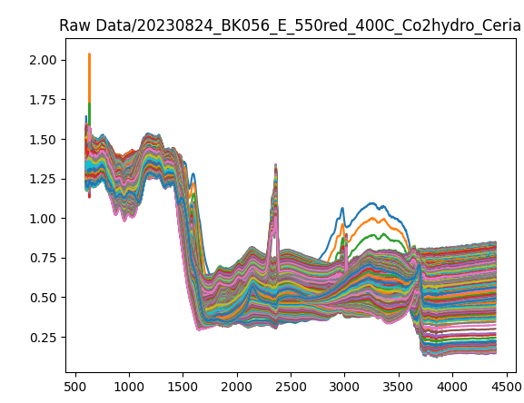
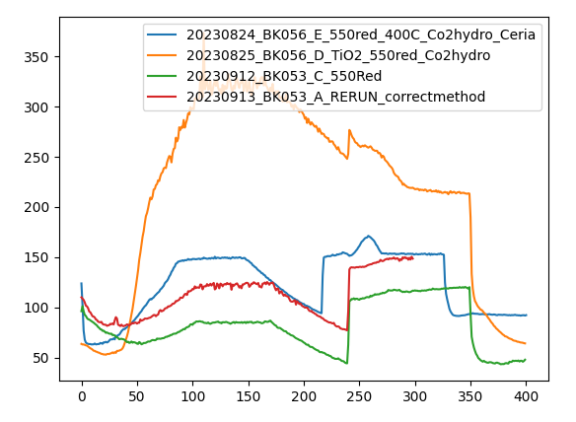
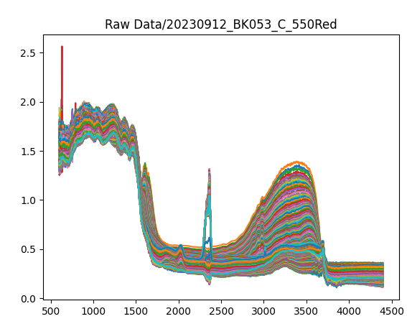
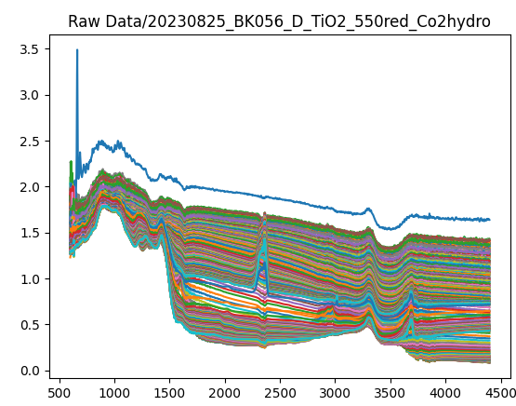
Result from level 4

Slide 18
Do it yourself!
Take a script you already have for processing/analyzing some data
Write functions if you have not already
Make a class with your functions and which loads your data
Make an IRSpectrum class.
Add attributes (wavenumbers, intensities, logfile)
Add methods (plot, …)

